Slide 1
RTI ACT 2005
Dr.P.DEVI

Slide 2


Slide 3


Slide 4
What is RTI?
Right to information popularly known as RTI is a fundamental right given by our constitution under article 19.1.
The article 19.1 says that every citizen has freedom of speech and expression.
In 1976 the Supreme Court said that people could not speak or express themselves unless they know.
Therefore the Right to Information is embedded in article 19.1 and is a fundamental right.

Slide 5
What is RTI?
In the same case court also said that India is a democracy and peoples are the masters; therefore, the masters or the people have a right to know how the government means to serve them are functioning.
Further, every citizen pays taxes; the citizens, therefore, have a right to know how their money was being spent.

Slide 6
Enactment of RTI
The RTI Act was enacted in 2005. It was passed in Lok Sabha on 11th of May 2005 and on 12 of May of Rajya Sabha by the UPA government.
It received the assent of President of India on 15th June 2005. Soon after 120 days, the Act came into force on 12 October 2005.
The objective of the Act was revolutionary when, because it opened all official departments across the country to public scrutiny.

Slide 7
The RTI Act was enacted in 2005. It was passed in Lok Sabha on 11th of May 2005 and on 12 of May of Rajya Sabha by the UPA government. It received the assent of President of India on 15th June 2005. Soon after 120 days, the Act came into force on 12 October 2005.
The objective of the Act was revolutionary when, because it opened all official departments across the country to public scrutiny.

Slide 8
The objective of Right to information act
To provide a legal framework of citizens democratic Right to access to information under the control of public authorities.
To promote transparency and ensure accountability.
To harmonise conflicting interest and priorities in operations of government, and use of resources.
To promote the practice of revelation of information to preserve democratic ideals.

Slide 9
RTI includes the Right to
To inspect works, document and records.
To take notes, extracts, or certified copies of documents and records.
Take certified samples of material.
To obtain information in the form of printouts, diskettes.

Slide 10
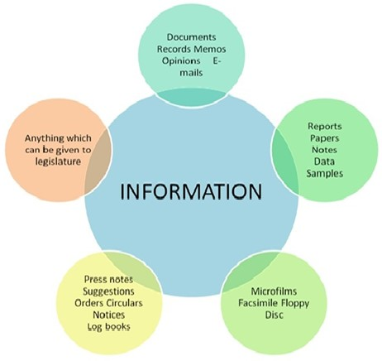
Information

Slide 11
What is the Public Authority?
Public Authority means a body or institution of self-government established or constituted
Under the constitution
Law made by the parliament of state legislative
By notification of the government
Body controlled or financed by government
Non-government body directly or indirectly by the funded by the government.
Every public authority must publish its obligations within 120 days of the enactment, which includes the functions, duties and the name of office bearers.

Slide 12
Procedure to apply for an RTI Application
The RTI can be claimed through two means, first through in writing mode or through electronic mode.
What is the Format of Application for filing RTI?
There is no prescribed format of application for seeking information.
The application can be made on plain paper.
The applications, however, have the name and complete postal address of the applicant.
What language is used in an RTI application?
The application can be in English, Hindi or any official language of the area. Which means language is not a barrier in filing an RTI.

Slide 13
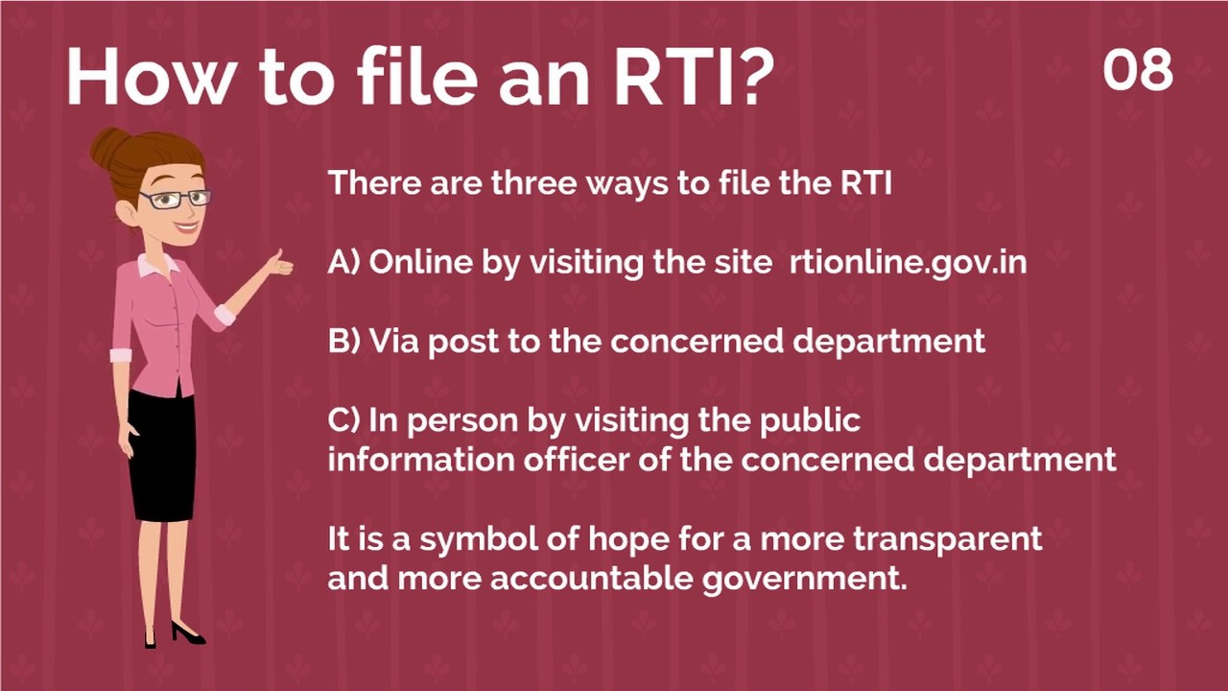

Slide 14
What can be the reasons for seeking information?
There is no need for the applicant to specify any reason for seeking RTI.
A person can file it whenever he or feels certainty of any doubtful activity.
Is there any Assistance provided to file RTI?
If a person is unable to make written request, the Public Information Officer PIO should render him reasonable assistance.

Slide 15
What fees are charged for seeking Information through RTI?
As per the RTI Act, the fees required should always be reasonable, and it is mandatory for the organisation to prescribe the fees. If extra fees are required to produce the information, then the same must be intimated in writing with calculation details of how the figure has arrived.
The fee is not required for citizens below poverty line category.

Slide 16
How much time shall a person wait for receiving information?
Normally the duration is of 30 days from the date of application to receive the information. But if the matter is related to Life and Liberty, the time limit for the Public Information Officer to provide information is 48 hours.
Five days shall be added to the above response time, in case the application for information is given to the assistant public information officer.

Slide 17
If the interest of the third party is involved, then the time limit will be 40 days.
Failure to provide information within the specified period is deemed refusal.

Slide 18
Rejection /Refusal
What are the grounds for rejection for refusal of RTI application?
An application can only be rejected if it is covered by exemption from disclosure, or if it infringes the copyright of any person other than the State then these can be served as a ground for rejection.

Slide 19
RTI ONLINE
Department of Personnel & Training has launched a web portal namely RTI online with URL www. rtionline.gov.in for all Central Ministries/Departments.
This is a facility for the Indian citizens to file RTI applications and first appeals online to all Central Ministries /Departments. The prescribed RTI fees can also be paid online.
Reply to the RTI applications and first appeals received online can also be given online by the respective PIOs/FAAs.

Slide 20
Information Exempted From Disclosure
However, the following types of information would continue to be exempt and there would be no obligation, even after lapse of 20 years, to give any citizen-
(i) Information, disclosure of which would prejudicially affect the sovereignty and integrity of India, the security, strategic, scientific or economic interest of the State, relation with foreign state or lead to incitement of an offence;
(ii) Information, the disclosure of which would cause a breach of privilege of
Parliament or State Legislature; or
(iii) Cabinet papers including records of deliberations of the Council of Ministers, Secretaries and other Officers subject to the conditions given in proviso to clause (i) of sub-section(1) of Section 8 of the Act.

